Slide 1
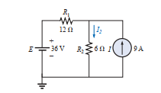
Superposition theorem
1. Using superposition, find the current through the 6 Ω resistor of the network
I₂=8A

Slide 2

Superposition theorem
2. use the superposition principle to determine the value of ix
I_{x}=1.4 A

Slide 3
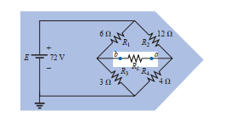
Thevenin theorem
3. Find the Thévenin equivalent circuit for the network in the shaded area of the bridge network
V_{th} = 6V
R_{th} = 5Ω

Slide 4
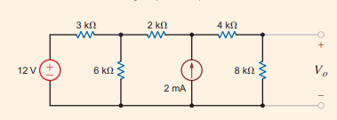
Norton theorem
4. Find the Norton equivalent circuit at A-B and find V₀ for the network
I_{N}= 2mA
V₀ = 8V
R_{N} = 4kΩ

Slide 5

Thevenin theorem
5. Find the Thévenin equivalent circuit for the network
V_{th} = 8V
R_{th} = 10kΩ

Slide 6
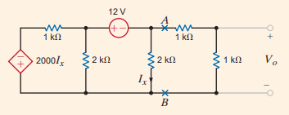
Norton theorem
6. Find the Norton equivalent circuit at A-B and find V₀ for the network
I_{N}= -18mA
V₀ = -18/7 V
R_{N} = 1/3 kΩ

Slide 7
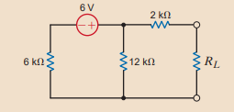
maximum power transfer theorem
7. find R_{L} for maximum power transfer and the maximum power transferred.
R_{N} = 6kΩ
P_{L}= 0.66mW

Slide 8
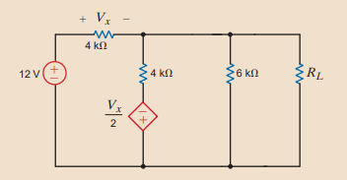
maximum power transfer theorem
8. find R_{L} for maximum power transfer and the maximum power transferred.
R_{N} = 24/13 kΩ
P_{L}= 27/26 mW

Slide 9
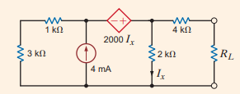
maximum power transfer theorem
9. find R_{L} for maximum power transfer and the maximum power transferred.
R_{N} = 2 kΩ
P_{L}= 8/3 mW

